Slide 1
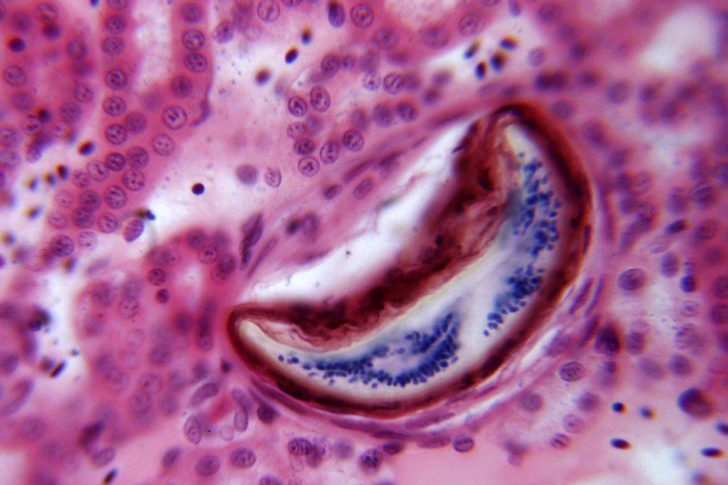
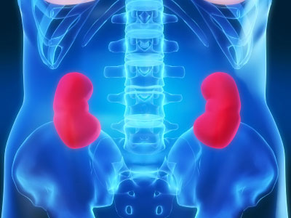
Chronic Kidney Disease
NICE Guidelines 2008
Dr Jennifer Kuo Dr Naeema Rashid Dr Shamita Das

Slide 2
Aims
To summarise latest NICE guidelines
To cover
  Early identification
  Management
In chronic kidney disease in both diabetic
and non diabetic adults in primary and
secondary care

Slide 3
NICE recommends that… (for non diabetics…)
We offer testing to the people with the following risk factors
Hypertension
Cardiovascular disease
Structural renal disease
  renal calculi
  prostatic hypertrophy
Multisystem disease with potential kidney involvement eg SLE
Family history of stage 5 CKD or hereditary kidney disease
If non of the above, NICE recommends that we do not use age gender or ethnicity as a marker

Slide 4
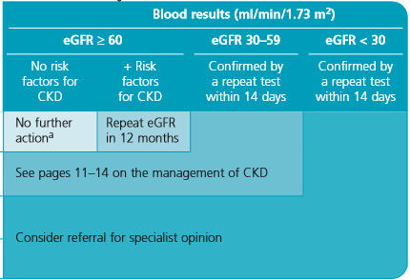
Screening…
Measure the GFR
  If GFR is <60 ml/min/1.73 repeat within 14 days

Slide 5

Screening… (cont)
Urine ACR or PCR
  If possible use ACR in preference to PCR as it has a greater level of sensitivity

Slide 6
NICE recommends that… (in the diabetic…)
We assess these patients annually
If eGFR is >60 continue annual screening
If eGFR 30-59 manage in community
If <30 refer to specialist

Slide 7
Management
Information and education
Lifestyle advice
    Dietary (protein potassium phosphate calories and salt)
    Encourage exercise
    stop smoking
Renal USS if
    Progessive CKD
    Visible/persistent haematuria
    Symptoms of UTI
    FH of polycystic kidney disease
    Stage 4 – 5 CKD

Slide 8
Progressive CKD…
Definition =
Decline of eGFR >5 ml/min/1.73 within 1yr
Decline of eGFR >10 ml/min/1.72 within 5yr
Confirmed by =
x3 readings over 90 days
Management of Progressive CKD
Optimise health of patients with risk factors
Consider need for renal replacement therapy

Slide 9
When to refer…
CKD 4-5
High proteinuria
Proteinuria with haematuria
Rapidly declining eGFR
Poorly controlled HTN
Suspected rare or genetic causes of CKD
Suspected renal artery stenosis

Slide 10
Other complications….
Control BP
Reduce CVD risk eg statin antiplatelet
Manage bone conditions (Mg Phos PTH)
Test for anaemia
There is no medical treatment of CKD however need to optimise medication eg stop nephrotoxic drugs and offer ACEi/ARB in diabetics or non diabetics with HTN.

Slide 11
Thank you

Slide 12
Question 1
Which one of the following is NOT a risk factor for CKD
  Hypertension
  Cardiovascular disease
  SLE
  Asian Origin
  Prostate hypertrophy

Slide 13
Question 2
Which of the following woud you NOT refer to specialist care?
  Genetic cause of CKD
  Renal artery stenosis
  Proteinuria ACR >30
  CKD 4
  Diabetic CKD 5

Slide 14
Question 3
Which of the following drugs would you consider in a patient with diabetes who is normotensive
  Ramipril
  Amlodipine
  Bisoprolol
  Diltiazem
  None of the above

