Slide 1
Using The Arts in GP Training
Rachel Boyce

Slide 2
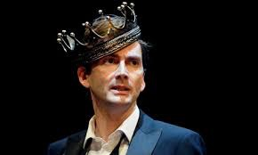
David Tennant
Hamlet
RSC, 2008
Dir Gregory Doran
click

Slide 3
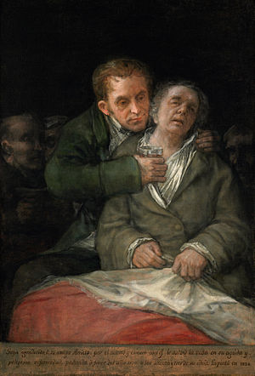
Self-portrait with Dr Arrieta (Francisco Goya, 1820)
“Goya, in gratitude to his friend Arrieta: for the compassion and care with which he saved his life during the acute and dangerous illness he suffered towards the end of the year 1819 in his seventy-third year.”

Slide 4
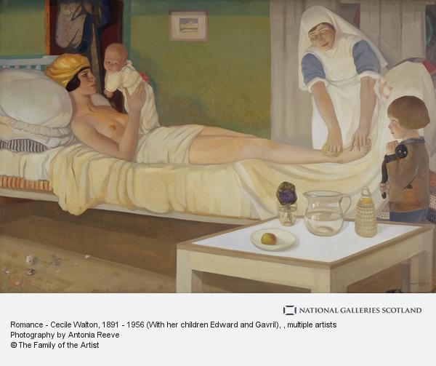

Slide 5
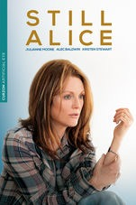
‘Still Alice’ (2015)
Directors:
Richard Glatzer
Wash Westmoreland
Julianne Moore, Alec Baldwin, Kristin Stewart
click

Slide 6
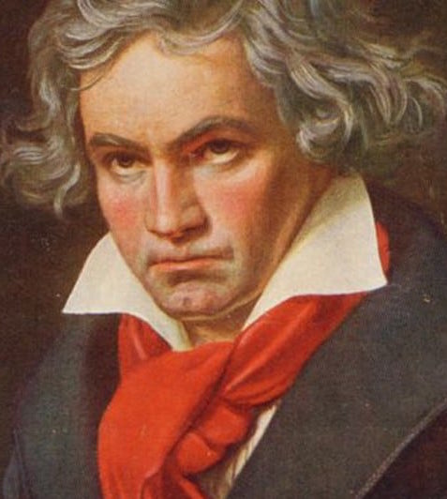
Beethoven’s Piano Concerto No. 4, 2nd Movement
click

Slide 7
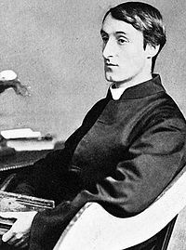
‘Felix Randal’
Gerald Manley Hopkins
(written 1880, pub 1918)

Slide 8
How to read a poem!
what is it about?
whose voice are you hearing?
what feelings/ emotions does it invoke in you?
what images or memories does it invoke?
what metaphors does the poet use?
what is the poet saying (or trying to say)?
what do you like about it?
is there anything in the poem that makes you see something in a new light?
are there any echoes in the poem from your own experience?

Slide 9
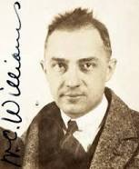
‘Dedication for a Plot of Ground’ (1938)
William Carlos Williams

Slide 10
How to read a poem!
what is it about?
whose voice are you hearing?
what feelings/ emotions does it invoke in you?
what images or memories does it invoke?
what metaphors does the poet use?
what is the poet saying (or trying to say)?
what do you like about it?
is there anything in the poem that makes you see something in a new light?
are there any echoes in the poem from your own experience?

