Slide 1


2019 ARCP briefing slides
Health Education England working across Thames Valley
V1 3.2019

Slide 2
Welcome
Thank you
  For preparing for today by scrutinising the e-portfolios
  For attending today to support the process
  For giving feedback to trainees on their Outcomes
V1 3.2019

Slide 3
Who’s who and roles today
Chair of the panel – Kim Emerson
Programme Manager and/or Recruitment & Assessment Administrator –
Lucianna Zandonadi
Lay Representative – N/A
Panel members –
  Perihan Colyer
  Suzie Gill
  Ann Sanders
  Richard Silvester
  Kate Staveley
External Representative Tara George (RCGP/EA)
Academic Representative (if applicable)- None
Visitors – None
Please nominate a panel member to complete the revalidation check list
(completed by Admin/Panel Chair in GP, Panel Chair for Foundation)

Slide 4
Purpose and scope of ARCP panel review
To review the material in the trainee’s portfolio and issue an outcome having mapped the evidence submitted to that required for demonstrating progress in the specialty curriculum
ONLY material submitted in the portfolio can be considered by the ARCP panel
The trainee’s ES must not be involved in panel discussions if they are present at the review
V1 3.2019

Slide 5
Fitness to Practise
‘Fitness to Practise’ is separately considered as part of the process to support the Dean’s recommendation for revalidation
There needs to be follow-up (by TPD and / or ES) to ensure actions recommended by the ARCP panel actually happen
V1 3.2019

Slide 6
Tasks for the panel
Participating in the discussion about a trainee’s evidence of progression and fitness to practise
Piloting / driving the ePortfolio
Completing a draft ARCP outcome form once a decision is made
Completing form /checklist to support revalidation
Completing a feedback sheet for the ES on their report
Lay, External and Dean’s reps will all produce a report on the ‘event’
V1 3.2019

Slide 7
Outcomes
1-6 for all trainees holding a number and ‘in programme’
The ‘7’ prefix is used only for trainees without an NTN (eg LATs)
The ‘8’ prefix is for trainees currently ‘out of programme’
There are reference sheets describing outcomes on the table
V1 3.2019

Slide 8
Trainees with two ARCP outcome forms
Those ‘dual accrediting’ (mainly in medical specialties)
Those whose Form R arrived after the predetermined deadline (TWO WEEKS before the ARCP), but before the ARCP panel review must be issued a 5 then the training outcome- overruled for GP and as long as in place at date of panel no outcome 5
Those who have spent part of the year in research and part in clinical training need one for each phase, ditto maternity leave / long term sick leave
V1 3.2019

Slide 9
N and U codes
All trainees must have an annual update on training progression (Foundation, Core and Specialty, Full and Less than Full Time)
If there is no, or insufficient (e.g. less than 3 months whole time equivalent) training to review, then a U or N code should be uploaded
N = no outcome U = unsatisfactory outcome
Both have drop down menus on electronic forms to expand narrative
V1 3.2019

Slide 10
‘Interim’ and / or ‘mop-up’ ARCPs
These are formal reviews
  May be called after an unsatisfactory outcome to monitor progress since remedy was prescribed
  May be to review the evidence leading to an Outcome 5 being issued to determine revised Outcome
  An Outcome should be issued
  Some specialties review trainees six months after programme commences at an 'interim review' which is NOT an ARCP even if on the same day as ARCPs
V1 3.2019

Slide 11
Less than full time trainees
Should be reviewed annually
Accrual of work place based assessments and other curriculum requirements is assessed ‘pro rata’
  50% WTE = 50% of evidence
V1 3.2019

Slide 12
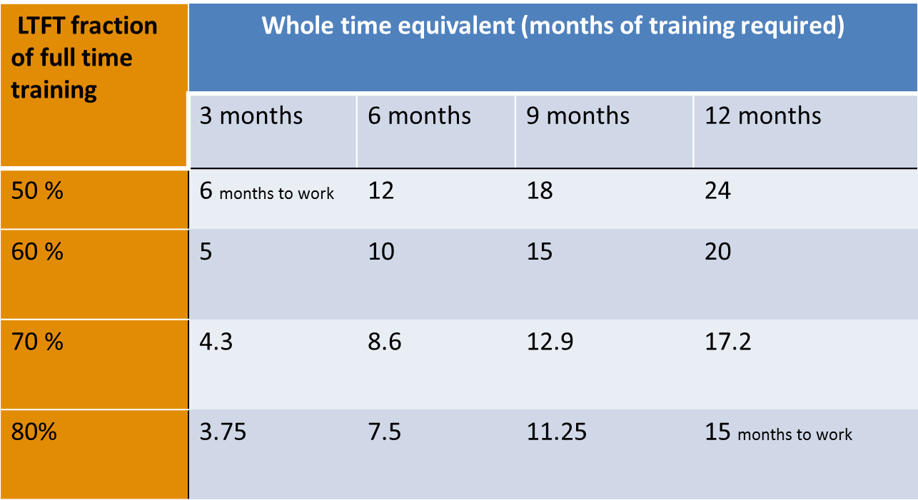
Ready-reckoner for LTFT training
V1 3.2019

Slide 13
Revalidation Basics
Revalidation dates are set by the GMC and are not automatically linked to ARCP or CCT dates.
Trainees should be revalidated every 5 years and additionally at CCT (subject to sufficient evidence/no ongoing concerns).
Trainees must maintain their connection to the correct Designated Body throughout their training period. OOP does not change this.
ARCP is not instead of revalidation but provides the main source of evidence to support it.
Trainees who have held non-training posts before or between training programmes are expected to have had and provide an appraisal for this work (send to revalidation.tv@hee.nhs.uk).
V1 3.2019

Slide 14
ARCP Revalidation: Evidence Checklist (1)
The Panel must review all the evidence relating to revalidation and fitness to practise:
Form R (Part A and B)
Whole scope of practice form for work that is not part of training (has it been signed off at the place work carried out and by the ES?)
ES Report (or equivalent for OOP/Academic trainees) including statement regarding any SIRIs or other concerns
Exception reports from employers (if applicable)
Serious or immediate fitness to practise concerns identified?
Ensure that the RO is notified (Revalidation.tv@hee.nhs.uk)
V1 3.2019

Slide 15
ARCP Revalidation: Evidence Checklist (2)
For any SIRIs, incidents, complaints or other issues:
  Has the trainee appropriately declared and reflected on the relevant concerns?
  Has the trainee updated on any previously declared concerns – are these now resolved?
  Are any of the concerns ongoing (e.g. SIRI investigation not yet undertaken, disciplinary hearing pending)?
  Does the panel believe that these impact on the trainee’s fitness to practise?
Serious or immediate fitness to practise concerns identified?
Ensure that the RO is notified (Revalidation.tv@hee.nhs.uk)
V1 3.2019

Slide 16
ARCP Revalidation: Evidence Checklist (3)
Remember the trainee is expected to declare all levels of concerns, employers generally report the higher level ones only. The ES and trainee should be aware of anything the employer has reported.
Please complete the ARCP Revalidation Checklist for each trainee and the revalidation section on the ARCP Outcome Form.
Serious or immediate fitness to practise concerns identified?
Ensure that the RO is notified (Revalidation.tv@hee.nhs.uk)
V1 3.2019

Slide 17
Revalidation and ARCP outcome
Late Form R = Outcome 5- if not present at date of panel
Outcome 1 or 6 cannot be given until Form R provided
If awarding Outcome 5, indicate on the Revalidation ARCP Checklist what the likely outcome will be
Update CCT date (even if estimate) - this helps the Revalidation Team ensure a trainee has a recommendation made at the correct point in training
Form R required for each ARCP (unless on same day)
Virtual Panels for Outcome 6 – please ensure Revalidation Team are made aware and that a Form R has been completed (or at the very least the trainee must confirm nothing additional to declare)
V1 3.2019

Slide 18
Local Arrangements
ARCP panel Chair
  Please feel free to add any specialty specific issues here
  Lack of GMC survey completion should be noted in ARCP form, ideally a reflective log should be written but no outcome 5 will be awarded
  As long as ESRs completed by date of panel no outcome 5
  Feedback for ESs from list of quotes or other info, emailed unless adverse in which AD emailed to feedback and support
  Conflicts interest PD for trainee no special involvement fine, if trainee worked in practice, personally known or ES to them must not be part of panel
V1 3.2019

Slide 19
Outcomes
Outcome 1: Satisfactory progress – Achieving progress and the development of competences at the expected rate.
Outcome 2: Development of specific competences required – additional training time not required.
Outcome 3: Inadequate progress – additional training time required.
Outcome 4: Released from training programme with or without specified competences.
Outcome 5: Incomplete evidence presented – additional training time maybe required.
Outcome 6: Has met all the required clinical competences to complete the training programme and will be recommended for award of a CCT .
Outcome 8: Out of programme.

Slide 20
Reasons for outcome 5s
Missing assessments COTS/Mini-cex/CbDs/ CSR/MSF/PSQ
Exam results pending
Missing evidence AED/CPR/safe guarding
Missing OOHs at final ARCP, no longer at ST1/2

Slide 21
CPD
You can claim up to two CPD points per year through attendance / involvement with an ARCP panel
Please ask the Chair or EPM (Education Progamme Manager) for a certificate
V1 3.2019

Slide 22
Thank you
Any comments / queries / suggestions, please contact
  Rebecca Black, Associate Dean
    Rebecca.black@hee.nhs.uk
V1 3.2019

