Slide 1
The ePortfolio – who cares?

Slide 2
Why does it matter?
You can’t get your CCT unless you pass WPBA

Slide 3
ARCP Outcomes 2013
Outcomes 1 and 6 (satisfactory progress/ recommendation for CCT) 1204
Outcome 5 (incomplete evidence- further training time may be necessary) 420
Outcome 3 (unsatisfactory progress- further training time needed) 36
Outcome 2 (development of specific competencies required, no further training time – cannot be given as final outcome) 13
Outcome 4 (unsatisfactory-released from training) 11
Outcome 8 (OOP) 18

Slide 4
Why do trainees get outcome 5?
No SEA –personal reflection only
Not enough clinical encounters
Audit not uploaded
No enhanced form R/ form R not signed
No CPR/ safeguarding
All requirements listed in the LSGP Training and Education Guide – on Synapse

Slide 5
What is needed?
You need to demonstrate that you have satisfied all 12 RCGP competences by the end of ST3
This is NOT the same as curriculum coverage

Slide 6
Competences
To be demonstrated through the ePortfolio – clinical encounters; SEAs; audit/ QIP; CBDs; COTs
2 REFLECTIVE clinical encounters per month, plus 2 other entries
2 SEAs per year
Varying numbers of COTS and CbDs depending on which year you are in
Try to get 3 pieces of evidence per competency every 6 months

Slide 7
Learning log entries
You can select which curriculum statements you think fit your log entry (no more than 2 per entry)
Your ES links competences, but ONLY if the log entry is clearly about that competency AND you have made a clear reflection and analysis in terms of that competency
Usually no more than 1-2 competences per clinical encounter

Slide 8
Learning logs – clinical encounters
What makes an entry reflective?

Slide 9
ISCE
Information
Self awareness
Critical analysis
Evaluation/ evidence of learning

Slide 10
CBDs
The aim of CbD is to explore professional judgement in clinical situations. You should choose cases which show how you are able to:
recognise uncertainty/complexity
apply your medical knowledge
apply or use ethical and legal frameworks
prioritise options, consider implications and justify decisions.

Slide 11
CBDs – the process
For each CbD, you should select THREE cases and present a copy of the clinical entry and medical summary to your trainer one week before
You should ideally indicate which of the RCGP competences the CBD highlights – probably about 2-3 competences per CBD.
The trainer selects TWO of these cases for further discussion.

Slide 12
CBDs - tips
Choose a variety of different cases
Make sure you understand what each competency means
Be strategic – choose cases which demonstrate competences you don’t have much evidence for

Slide 13
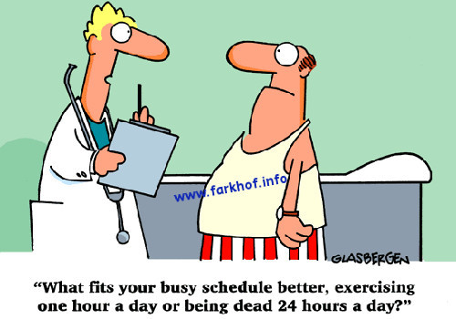
COTS
An assessment of a GP consultation
No set duration for the consultation
Aim for a variety of cases- children, older adults, mental health problems and cancer/ palliative care

Slide 14
COTS
The competences which are designed to be assessed by COTS are:
Clinical management
Communication skills (unlike CBDs)
Data gathering and interpretation
Making diagnoses and decisions
Holistic approach

Slide 15
Competency 10
Need audit or QIP!
Also two SEAs per year.
MUST show evidence of team discussion and process change for the SEA

Slide 16
Competency 10
Need audit or QIP!
Also two SEAs per year.
MUST show evidence of team discussion and process change

Slide 17
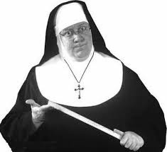
Form R
Enhanced form R – needed annually
Need to declare SUIs (not all SEAs); sick leave; probity issues

