Slide 1
Best Bets
Helen Reay & Kate Shipton

Slide 2
PICO
P: Women with vulvovaginal candidiasis
I: Oral Fluconazole
C: Topical Clotrimazole (Pessary ± Cream)
O: Resolution of symptoms

Slide 3
Search strategy
PubMed search using terms
“Vaginal Thrush, Vaginal Candida, Vulvovaginal Candida, Vulvovaginal thrush”
AND “Management, Treatment, Oral vs Topical Treatment OR Management”
48 articles initially, 27 articles rejected as clearly not relevant
Most recent cochrane review identified in 2007
All articles prior to this not reviewed
Cross referencing from relevant article citations

Slide 4
Exclusion criteria
Recurrent candida
Alternative sites of candida
Specific populations eg diabetics
Treatments other than clotrimazole or fluconazole
Comparisons of candida and STIs
Short term cure

Slide 5
Search Outcome
1 x Cochrane review
1 x Clinical Trial
2 x literature reviews

Slide 6
Oral versus intra-vaginal imidazole and triazole anti-fungal treatment of uncomplicated vulvovaginal candidiasis (thrush) (Review)
Nurbhai M, Grimshaw J, Watson M, Bond CM, Mollison JA, Ludbrook A
Cochrane Database of Systematic Reviews 2007
No declerations of interest
1

Slide 7
Clinical Cure - Short term Fluconazole VS Clotrimazole
 | Studies | Participants | Statistical Method | Effect Size
Total | 6 | 1055 | Odds Ratio (M-H, Fixed, 95% CI) | 0.88 [0.66, 1.16]
RCTs | 5 | 1047 | Odds Ratio (M-H, Fixed, 95% CI) | 0.76 [0.59, 0.99]
Single doses (SD) | 3 | 585 | Odds Ratio (M-H, Fixed, 95% CI) | 0.74 [0.52, 1.06]
SD vs 6-7 day topical treatment | 2 | 285 | Odds Ratio (M-H, Fixed, 95% CI) | 1.38 [0.80, 2.37]

Slide 8
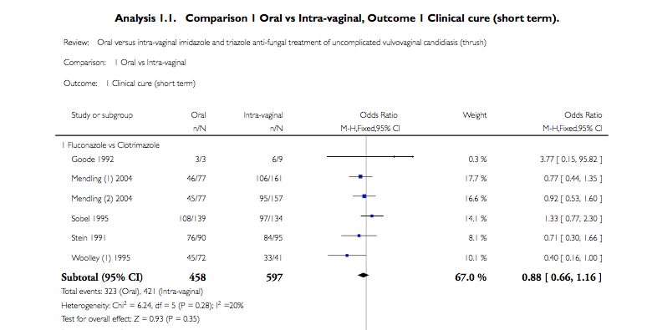

Slide 9
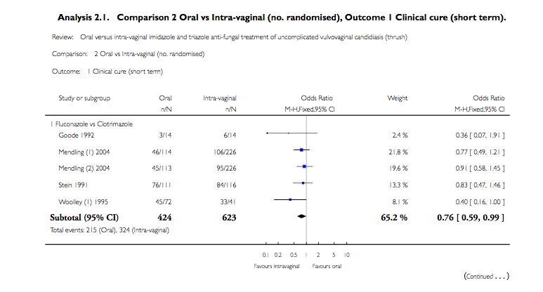
Heterogeneity: Chi2 = 3.31, df = 4 (P = 0.51); I2 =0.0% Test for overall effect: Z = 2.01 (P = 0.044)

Slide 10
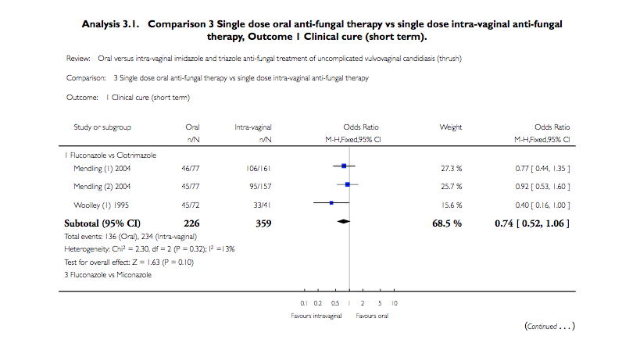

Slide 11
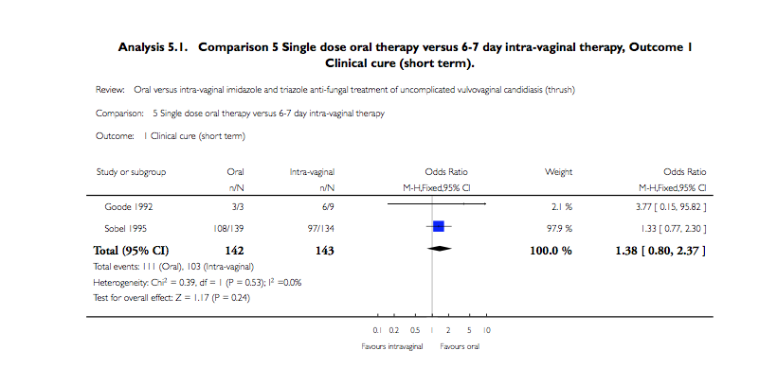

Slide 12
Results analysis
No statistically significant difference between oral and intravaginal treatment
>70% of subjects achieved clinical cure
6 of the studies reported compliance checks
Therefore cure rate may be higher
1 study suggested that time to first relief of symptoms was shorter with topical therapy (Seidman 2005)
1

Slide 13
Results analysis
Some suggestions for ‘unresponsive women’ (ie treatment didn’t seem work)
eg Most studies excluded women with vaginitis due to other causes or concomitant infection BUT it is possible where subjects had an undiagnosed genital infection this may have contributed to their clinical symptoms
Mycological cure was 83% for oral and 80% for intravaginal
Inclusion criteria – clinical symptoms vs micological diagnosis
Cost and patient preference
1

Slide 14
Oral fluconazole 150 mg single dose versus intra-vaginal clotrimazole treatment of acute vulvovaginal candidiasis
Leila Sekhavat, Afsarosadat Tabatabaii, Fatemah Zare Tezerjani
Department of Obstetrics & Gynecology, Shahid Sedughi Hospital, Shahid Sedughi University of Medical Sciences and Health Services, Yazd, Iran
Only had access to abstract
Method: 142 patients, randomised to 2 groups – 70 for intravaginal treatment (200mg) and 72 for oral treatment (150mg)
2

Slide 15
Results at 1 month
Fluconazole Group: 61 patients (84.7%) were cured clinically (inflammation and discharge) and 58 patients (80.5%) mycologically
Clotrimazole group: 60 patients (83.3%) were cured clinically and 49 patients (70%) mycologically
(P = 0.01) – where NH is fluconazole is NOT effective compared to clotrimazole
2

Slide 16
Treatment of vulvovaginal candidiasis: a review of the literature
Andraz Dovnik et al, 2015
Acta dermatovenerologica journal
Short term local therapy or single dose oral treatment is effective for treating 90% of uncomplicated cases…no single agent seems to be clearly superior to others
3

Slide 17
Candidiasis (vulvovaginal)
BMJ Clin Evid. 2010 Jan 5;2010. pii: 0815.
General Practice, Glasgow University, Glasgow, Scotland
Systematic review used the cochrane review

Slide 18
Changes to clinical practice
Clinical outcomes not significantly different
Therefore cost and patient choice will influence prescribing practice

