Slide 1
Signs of Safety
Dr Sharon Kefford
Named GP Childrens Safeguarding Surrey Countywide, North East Hants and Farnham,
NHS Guildford & Waverley CCG
Countywide Safeguarding Team
Notes:
Safeguarding risk assessment tool

Slide 2
AIMS
Awareness Signs of Safety Culture in Surrey
Signs of safety risk assessment tool
Use of signs of safer tool in general practice
Practice using tool in assessing / supervising a case
Use of signs of safety in MASH referral
Use of signs of safety in information sharing with Childrens services

Slide 3
Signs of Safety in Surrey.
2014 Ofsted Surrey Children, School and Family services – Inadequate.
Childrens Services systemic change
Whole systems failure loosing site child in the centre.
Whole systems approach impacting all agencies working with child.
What has worked well in other places?
Best practice, what does good look like?
Organisations that learn
Learning from good practice
Strength based practice – What do we do well?
NHS Guildford & Waverley CCG
Countywide Safeguarding Team

Slide 5
The Signs of Safety Approach
Developed 1990s
Andrew Turnell and Steve Edwards.
Western Australia in collaboration with over 150 child protection workers.
Model now used UK, USA, Canada, Netherlands, Sweden, New Zealand and Japan
NHS Guildford & Waverley CCG
Countywide Safeguarding Team
Notes:
Social workers in West Austrailia, family therapy observing techniques with families behind mirror

Slide 6
The Signs of Safety Approach
Risk assessment and case planning that is meaningful for professionals, children and families
Work with children and families, do this with them not to them. Participation.
Strength based, balances danger / harm alongside strengths and safety
Mapping tool
One page assessment
Simple / common language
NHS Guildford & Waverley CCG
Countywide Safeguarding Team
Notes:
Mapping tool
Strength based, families have strengths, resources and ability to recover from adversity. Worker supports family to help themselves.
Common language, children viewing records, conversations with parents clear what they must do, intuition v issue when discussing cases
Encourage families to help themselves.

Slide 7
How are signs of safety relevant to GP’S?
Tool for Safer Surrey ethos
Helpful in guiding questioning for risk assessment
Voice of the child
Communication between professionals and families using this framework and language
Communication to social services to help explain concerns in common language. Referral forms and information sharing.
Safeguarding reports and significant event analysis
Supervision
NHS Guildford & Waverley CCG
Countywide Safeguarding Team
Notes:
VOC – children growing up in similar circumstances but different impact on child, different impact one sibling to next,find out what is worrying the child is this the same as what is worrying you? Three Houses. What do they wish for?
Referrals what is it you are worried about? What has lead to that worry? (today, past child, experience with this family?)
Think re child viewing their record as an adult,
Supervision thinking through problems.

Slide 8
Signs of Safety Assessment and Planning Framework.
What are we worried about?
What's working well?
What needs to happen?
Where are we on a scale of 0-10 where 10 means there is enough evidence for the child protection authorities to close the case and 0 means we are certain the child will be (re ) abused?
NHS Guildford & Waverley CCG
Countywide Safeguarding Team
Notes:
Parents understand what professionals are worried about and what they need to do to get them out of their lives.
What needs to happen not a service, provision of safety to children in circumstances, how a service will lead to a change to protect child.

Slide 9
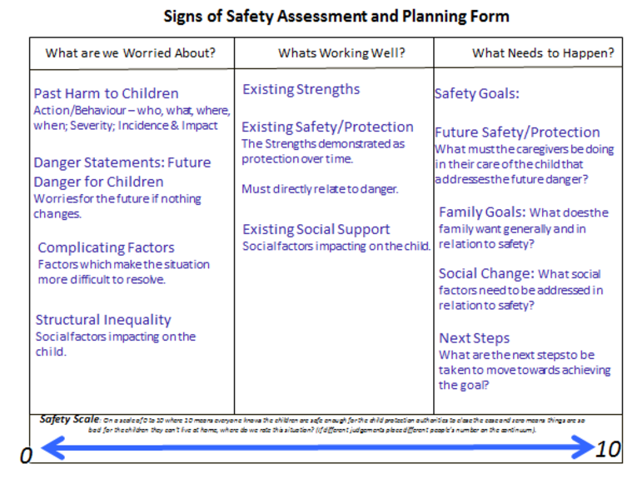
NHS Guildford & Waverley CCG
Countywide Safeguarding Team
Notes:
Past harm as an indicator of future harm, incidence how often many incidents map first/worst /most recent.
Danger statements- what are you concerned will happen to the family if nothing changes? Drug using mother as example
Factors making situation more complex for family and professionals, how do these impact the child. Is the professional making the situation better or more complicated? >4-5 professionals negative impact, what is this professional going to add?
Times when child in danger protected. Use positives to engage family . Think of times they have managed OK. Ask re network, who helps, who do children see as important in there lives, genogram.
Scaling
Safety goals what do you need to see to be satisfied the situation is safe enough to close the case? If attends a group what change do you want to see to show no longer using and for how long?
Steps to move towards goal closing case moving from3 to 4.

Slide 10
Surrey Signs of Safety Mapping Tool
What are you worried about?
(past harm, future danger, complicating factors)
What’s working well?
(existing strengths and safety)
What do we still need to know?
(grey areas, unknown information, where do we need further information)
What needs to happen?
(for future safety)
Notes:
Safer Surrey Additional question- What do we still need to know?

Slide 11
Case Study
Wednesday morning. Zoe a 14 year old girl comes into the surgery alone. Asks if consultation is confidential as she does not want her mum and Dad to know.
Discloses that she is feeling very low, cutting herself. 1 year. Tried to talk to her mum who told her nothing was wrong. Describes relationship with parents as reasonable, usual teenage disagreements minor.
Deals with emotions herself talking to friends, using APPs.
Doing well at school dislikes classmates but has other friends. Previously bullied. Does not want to talk to teachers, worried they will inform her parents.
Friends have told her she has mood swings and can start arguments.
Assess the risk for this child using signs of safety framework.
NHS Guildford & Waverley CCG
Countywide Safeguarding Team
Notes:
Read slide looking at mapping tools on handout. Shout out what going well? What are we worried about? What needs to change?

Slide 12
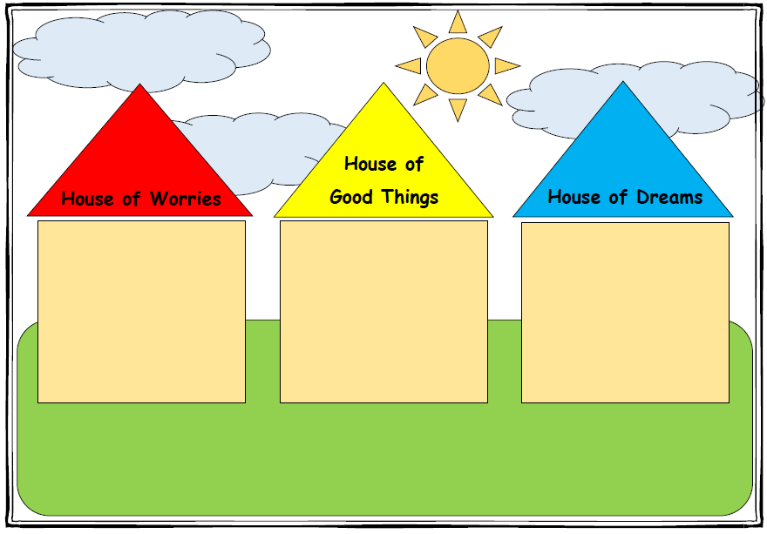
Talking to children. The Three Houses
NHS Guildford & Waverley CCG
Countywide Safeguarding Team
Notes:
Are the child's worries the same as yours? What is it the child wishes for? Eg parents to be together but NMO.

Slide 13
Referring.
4. Reason for Referral
What was the date and time of presentation? Was the child/young person present? YES NO If NO, please give details of where the child was at the time of referral and who they were with:
What are you worried about?
What does the history tell us?
What is working well?
What is not working well?
What do you consider to be the appropriate level of need for this case? Please refer to Surrey Levels of Need document for guidance.
NHS Guildford & Waverley CCG
Countywide Safeguarding Team
Notes:
May be asked 1. What are you worried about? 2. What has lead to that worry?
Level of need.

Slide 14
Information Sharing
A social worker asks you to complete a report for a child protection conference sharing information regarding the following family.(see Hand out).
You have just finished surgery and cleared your path links, it’s 7.30pm. You start to write the report for Ruby’s case conference.
Complete this Child Protection information sharing request using the Signs of Safety framework. Comment (in your opinion) on the current level of risk to the child.
NHS Guildford & Waverley CCG
Countywide Safeguarding Team

Slide 15
Analysis of Risk
What are we worried about?
Domestic violence
History of maternal mental health problems
Alcohol abuse
Pregnancy
Maternal lack of empathy for the child
Attachment issues
What is going well?
School have positive relationship with Ruby
Grandparents relationship and support.
Attended all developmental checks and vaccines up to date
Analysis
Child at significant risk of harm from neglect, lack of supervision, risk of witnessing or bring caught up in violence within the home and negative relationship with her mother.
NHS Guildford & Waverley CCG
Countywide Safeguarding Team

Slide 16
References
www.surreyscb.org.uk/professionals/guidance-protocols
www.surreycc.gov.uk
Safer Surrey approach -> Safer Surrey Toolkit
NHS Guildford & Waverley CCG
Countywide Safeguarding Team

Slide 17
NHS Guildford & Waverley CCG
Countywide Safeguarding Team

