Slide 1
ST1 Enhanced Support Programme
Roy Wallworth

Slide 2
Key Points
A component of the Differential Attainment resource
Attendees at ST1 level
Invitees are lowest 20% recruitment scores – PDT
Attendance is presented as ‘mandatory’
Small groups facilitated by DA champions and lead educators

Slide 3

Transformational teaching – the journey

Slide 4
Terms that are relevant
Values
How we determine what is important to us and act as a point of reference for judgement
Beliefs
Things that we hold to be true and are a point of reference for trust and confidence
Attitudes
Our state of mind with respect to a situation, person or thing.
Informed by our values and beliefs.

Slide 5
Terms that are relevant
Behaviours
The way we respond to a situation or stimulus
Influenced by attitudes
Culture
The ideas, customs and social behaviour of a particular people or society (way of life)
Health belief
A conceptual model used to explain how to maintain health and to provide an explanation for illness

Slide 6

Conscious competence descriptors
1 - unconscious incompetence
the person is not aware of the existence or relevance of the skill area
the person is not aware that they have a particular deficiency in the area concerned
the person might deny the relevance or usefulness of the new skill
the person must become conscious of their incompetence before development of the new skill or learning can begin
the aim of the trainee or learner and the trainer or teacher is to move the person into the 'conscious competence' stage, by demonstrating the skill or ability and the benefit that it will bring to the person's effectiveness

Slide 7
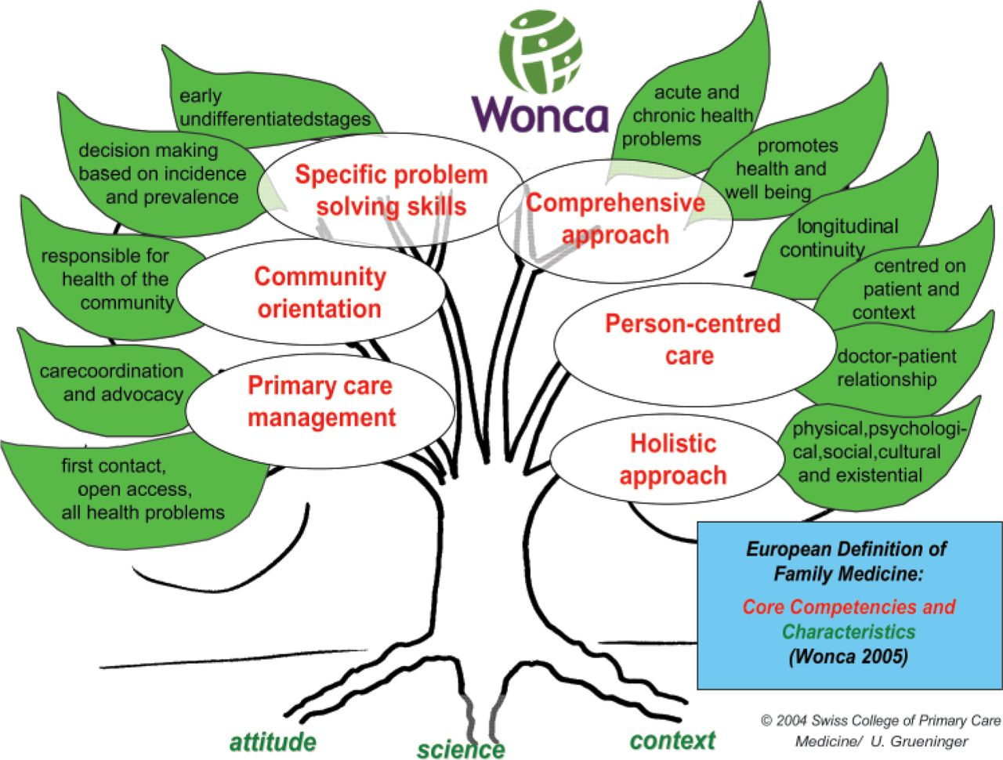

EURACT definition of primary care

Slide 8
Cognitive Competence
Skilled (competent) behaviour
Knowledge reproduction
Skills
competencies
Attitudes
Knowledge
Competences as sub-skills – W Westera

Slide 9
The seven facets of transformational learning
Activating event
Being open to alternative viewpoints
Engage in discourse/debate
Critical self-reflection
Transformational learning
Acting on revisions
Revising assumptions / values and beliefs
Articulating assumptions

Slide 10
Session design based on transformational learning
Group (at least two people) discussion with question to explore (articulating assumptions)
Presentation or presenting ideas or thoughts or viewpoints (activating event, being open to alternative viewpoints)
Mini breakout sessions of 10 minutes during presentation or presenting ideas or thoughts or viewpoints with questions to explore (articulating assumptions, engage in discourse or debate, being open to alternative viewpoints)

Slide 11
Session design based on transformational learning
Task to solve a problem scenario or critically appraise something (critical self-reflection, revising assumptions)
Task to apply new concepts to a personalised problem (acting on revisions)

Slide 12
Session 1 – WPBA and Reflection
Intro – What is WPBA and what is reflective practice and what do they mean to me
Presentation including breakouts
  GP curriculum and contextualised care
  Competent performance
  Blooms taxonomy – need for HOTS
  Utility of WPBA

Slide 13
Session 1 – WPBA and Reflection
Reflective practice an essential capability
Reflective writing – needs an action plan ‘so what’
Critical analysis versus criticism
Transformational learning (we are becoming GPs)
Practical example of a clinical scenario using HOTS

Slide 14
Session 1 – WPBA and Reflection
Reflecting on a learning log using critical analysis
Using a clinical scenario to generate a learning log

Slide 15
Session 2 Conscious Competence and SRL
Intro – what is a competent performance and how do you know you have done one
Presentation including small group breakouts
  Using and creating strategies
  Strategic thinkers and strategic thinking
  Conscious competence
  Dunning Kruger
  Self regulated learning cycle and process
  Practical example of creating a strategy

Slide 16
Session 2 Conscious Competence and SRL
Learning hacks presentation as a resource
  Interleaving
  Forced recall
  Self-assessment
How do we cope with challenge and negative feelings about progress
Formulate an SRL plan using a developmental need

Slide 17
Session 3 – AKT preparation
Recap on SRL and effective learning strategies
Constructive alignment and WPBA feedback
Using exam feedback
Learning from patients
Using resources available
Group work on answering AKT questions

Slide 18
Session 4 Consultation and COT introduction
Intro group
  How are GPs different to other specialities
  What is a consultation and what makes a good one
Presentation and breakouts
  COT is a map or a tool not a consultation
  Highly skilled
  Evidence based
  Listening versus hearing
  Use of terminology – what does ICE actually mean
  Health beliefs and incorporating health beliefs

Slide 19
Session 4 Consultation and COT introduction
Small group work
  Developing empathy (using an image trigger)
  Modifying health beliefs
  What does reassurance mean

Slide 20
Session 5 Introduction to the consultation
Intro Group
  30 minutes to write a story
Presentation including breakouts
  Lacking fluency and formulaic
  What style should it be
    Interrogation
    Interview
    Conversation
  Evidence to support conversation
  Listening styles and conversational sensitivity
  Effective conversations and when they go wrong

Slide 21
Session 5 Introduction to the consultation
Small group work
  Sharing stories
  Learning from conversations
  The challenges of conversations with patients
  Changing approaches to the consultation

Slide 22
Session 6 Design your own consultation
Builds on the consultation as a conversation
Defining key tasks
Creating a model for each group

Slide 23
Session 7 Developing skills for data gathering
Using TALC modules
Uses actor facilitators
Approach is like start/stop/rewind on video
Task based teaching based on actor feedback and unlimited attempts

Slide 24
Session 8 Developing skills for clinical management
Using TALC modules
Uses actor facilitators
Approach is like start/stop/rewind on video
Task based teaching based on actor feedback and unlimited attempts

Slide 25
Questions ?

