Slide 1
CREATING AND ASSIGNING CERTIFICATES OF SPONSORSHIP
A GUIDE FOR GP PRACTICES
October 2019
Guidance developed by the Department of Health and Social Care

Slide 2
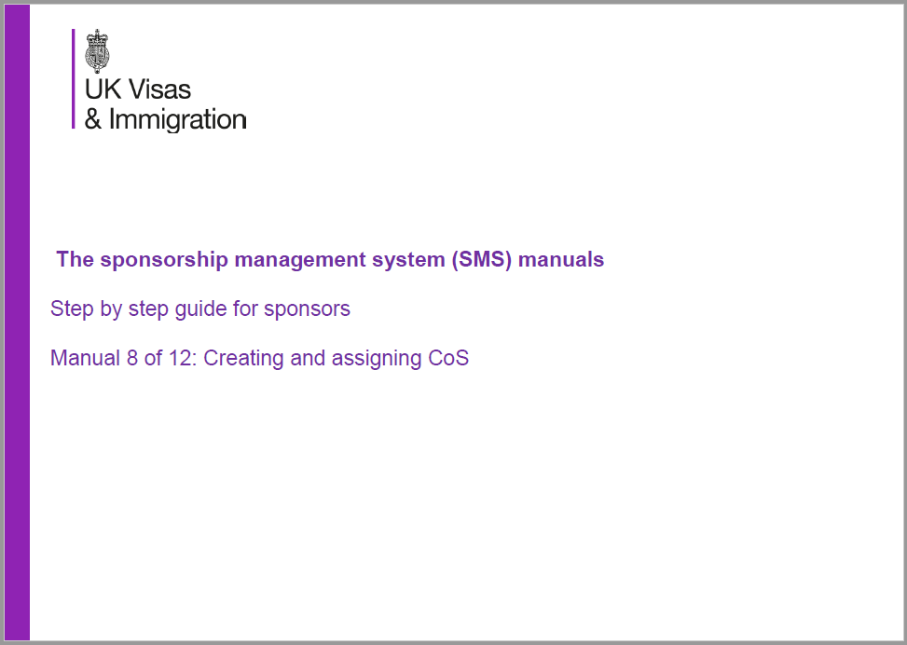
Introduction to Creating and Assigning Certificates of Sponsorship
As a Tier 2 visa sponsor, you can now create and assign Certificates of Sponsorship (CoS) which your prospective international recruits will use to obtain their Tier 2 visa.
The Home Office has produced guidance on this process, which gives information on how all sectors of the UK economy can create and assign COSs.
This guide is a tailored version for GP practices that should help you:
Create and assign your CoS; and
Provide the details of the CoS to your prospective international recruit.
This process is very straightforward and largely consists of data entry into an online form. That said, it is vital that all information provided is accurate. Any inaccuracies in the information provided can invalidate the visa awarded to an applicant and result in the revocation of the practice’s sponsorship licence and/or criminal proceedings.
Please note, we have only provided guidance on the questions which we think will be the most difficult to answer, not the entire application form. We have indicated which part of the process is being described on each slide.
This guidance does not replace official Home Office guidance, but should help you get through the registration process with ease.
Let’s get started…

Slide 3
What you need before you start
DOCUMENTS
We have created a checklist of all the information that you will need in order to complete the process of creating and assigning a CoS.
In short, you will need to have the following to hand in order to complete the process:
A copy of the applicant’s passport;
A copy of their professional registration certificate with the GMC;
Proof of the applicant’s current address (bank statement, utility bill etc.); and
Any information relating to previous UK visas that the applicant might have had.
TIMELINES
You should not to try to create and assign a CoS if the applicant’s start date is more than 3 months in the future. The system will not allow you to.
The applicant should be aware that, upon applying for a Tier 2 visa, they must begin their role within 4 weeks of the date the visa is issued, or the visa becomes invalid.
KEY PEOPLE
Creating and assigning a CoS will require you to access your SMS account. As such you will need to have the necessary authorisation to both access the account and to make a payment on behalf of the practice.
Given the importance attached to all information being provided accurately, we advise that either your Authorising Officer or a level 1 user completes this process. Alternatively, a level 2 user can complete the data entry part of the process, and the AO or a level 1 user can review the information for accuracy and make the necessary payments.
COST
Each CoS costs £199, payable once all of the required information has been entered into the online form.
There is also a Immigration Skills Charge that applies to new Tier 2 visas. This charge is £1000.
The Immigration Skills Charge does not apply to those applicants that are transferring from a Tier 4 to a Tier 2 visa.

Slide 4
Getting started
Log-in to your SMS account
Click on the ‘Workers’ tab in the left-hand drop down menu
Select ‘Create and Assign’ and answer the following questions
Select ‘No’ in the first box;
Select ‘Tier 2’ as the tier of visa for which you CoS will be used;
Select ‘Tier 2 General’ as the category of Tier 2 visa
Select ‘General (New Hires – Doctors/Nurses – ISC liable)’ under the sub-category options
Click ‘Next’

Slide 5
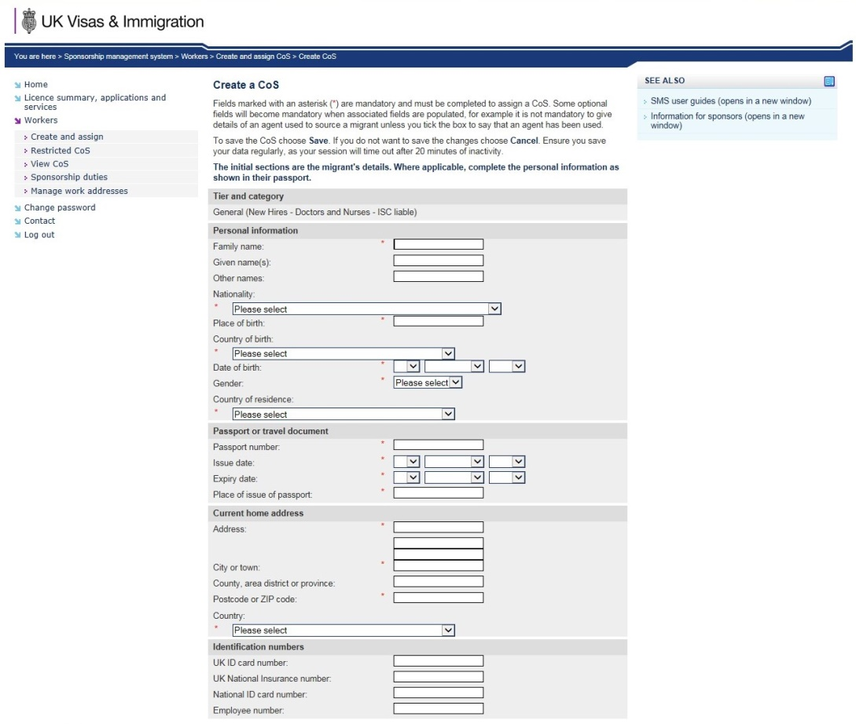
The Online Form
Completing the form
You will now need to complete the data entry stage of the process. This will include:
Personal information;
Passport/travel document information;
Address information; and
Job role information
Provided you have all of the documents listed on slide 3, all of the information required to be entered onto the form should be available to you.
NOTE: You do not need to complete the sections entitled ‘Identification numbers’ or ‘Agent’.

Slide 6
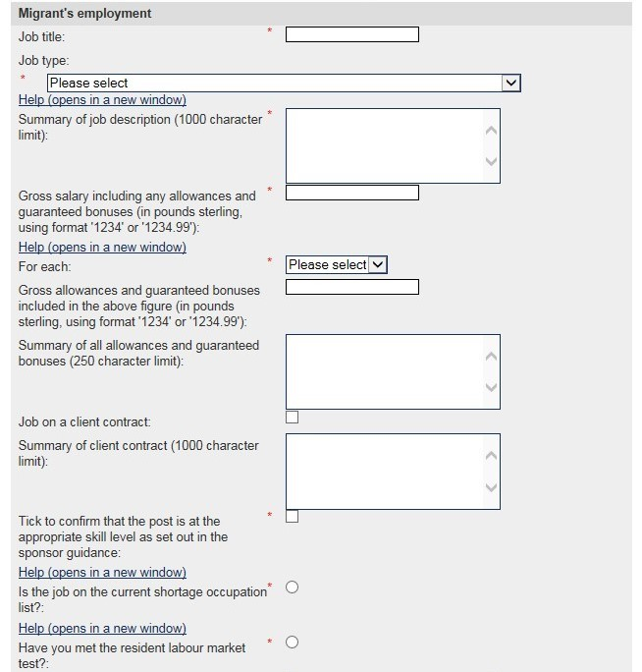
The Online Form
Migrant’s Employment cont.
Under job type select ‘Salaried GP and Equivalent’
Provide the job description as it appeared on the job advert, including the job reference number;
When entering the salary amount, include pounds and pence
This is all amounts that will be paid to the applicant above their base salary (doctor’s banding, London weighting, on-call allowances)
Tick the box confirming that the post is at the appropriate skill level
Tick the box confirming the job is on the Shortage Occupation List
DO NOT tick the box confirming that you have met the Resident Labour Market Test

Slide 7
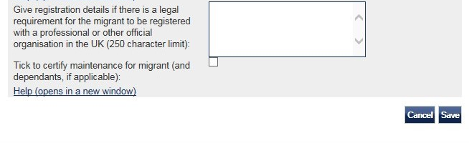
The Online Form
Job role information
In providing professional registration details, include the following:
The name of the professional body – General Medical Council
The start date of the applicants GMC registration; and
Their GMC registration number.

Slide 8
Final steps
Having entered all of the ‘Migrant’s employment’ information you will be directed through to a screen where you will need to provide the job SOC code. The SOC code for GPs is 2211 – Medical Practitioners.
Finally you will need to make the payment for the CoS. Once you have paid you will receive confirmation that your CoS has been created and assigned.
To view the CoS and share with your international applicant at a later date, you can log in to your SMS account, enter the ‘Workers’ area and select ‘Find an existing single certificate’. You can retrieve your CoS by searching the applicant’s passport number on the following page.
Once you have found your CoS you will be able to print or download it, and share with your applicant so they can make an application for a Tier 2 visa.

Slide 9
Useful contacts
Help and advice
If you do have any difficulty with the creation and assignation process, further advice can be obtained from the sponsorship, employer and education helpline:
Telephone:
0300 123 4699 Monday to Thursday, 9am to 5pm Friday, 9am to 4:30pm
Or email
businesshelpdesk@homeoffice.gsi.gov.uk

Slide 10
Reimbursement
NHS England and NHS Improvement will reimburse the following costs in relation to Certificates of Sponsorship and visa costs, to the practice via the relevant regional or local teams:
#
NHS England & NHS Improvement will only meet any costs that were incurred after 1 June 2018 and reimbursement forms must be submitted to NHS England & NHS Improvement before 31 March 2020.
Proof of payment must be provided.
For more information on reimbursement please contact England.Intrecruitment@nhs.net
Expense type | Cost incurred before 6 October 2019 | Cost incurred on and after 6 October 2019
Tier 2 visa application costs for the sponsored GP and their family | Usually £704 per person, but variable dependent on circumstances. See https://www.gov.uk/tier-2-general | Usually £464 per person, but variable dependent on circumstances. See https://www.gov.uk/tier-2-general
Certificate of Sponsorship costs | £199 per certificate. See https://www.gov.uk/uk-visa-sponsorship-employers/sponsorship-certificates | £199 per certificate. See https://www.gov.uk/uk-visa-sponsorship-employers/sponsorship-certificates
The first 2 years of the Immigration Skills Charge for any GP employed and sponsored on a tier 2 visa | £728 for small sponsors; £2,000 for medium or large sponsors. See https://www.gov.uk/uk-visa-sponsorship-employers/immigration-skills-charge | £728 for small sponsors; £2,000 for medium or large sponsors. See https://www.gov.uk/uk-visa-sponsorship-employers/immigration-skills-charge
Relocation costs for the sponsored GP and immediate family. Family is classed as those that will live at the GP’s home address in England | Up to £5000 | Up to £5000

