Slide 1
Bending not breaking

Slide 2
Aims
introduce the idea that wellbeing needs to be on our priority list
to increase awareness of our own resilience and the tools that we use to promote resilience

Slide 3
Objectives
recognize why being a GP is challenging
to share our own strategies for resilience and map them
to introduce and begin using PERMA & CCC models

Slide 4
Motivation Continuum
EXTRINSIC
MOTIVATION
INTRINSIC MOTIVATION
AMOTIVATION
Notes:
Extrinsic = carrot and stick
Intrinsic motivation more healthy... Cos it’s important to you. Linked to better learning, well-being and health.

Slide 5
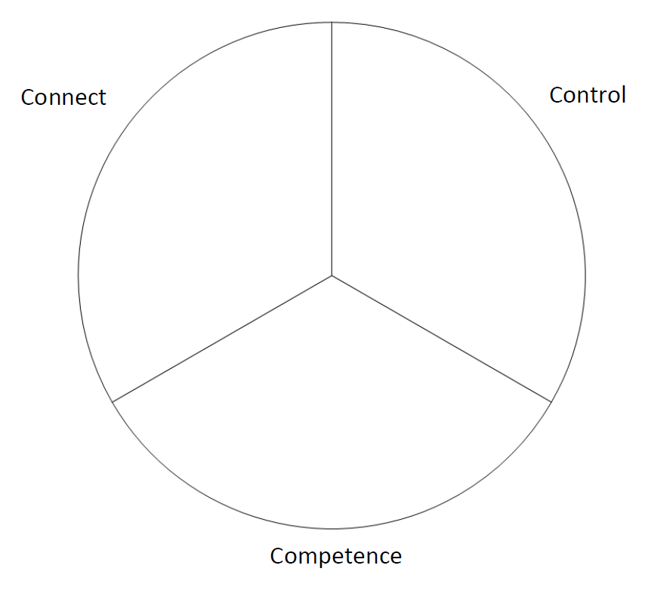
Notes:
3 human needs to honour which build motivation;
Relatedness to group (and those seeking a goal)= connection
Autonomy- in control of your destiny
Competence

Slide 6
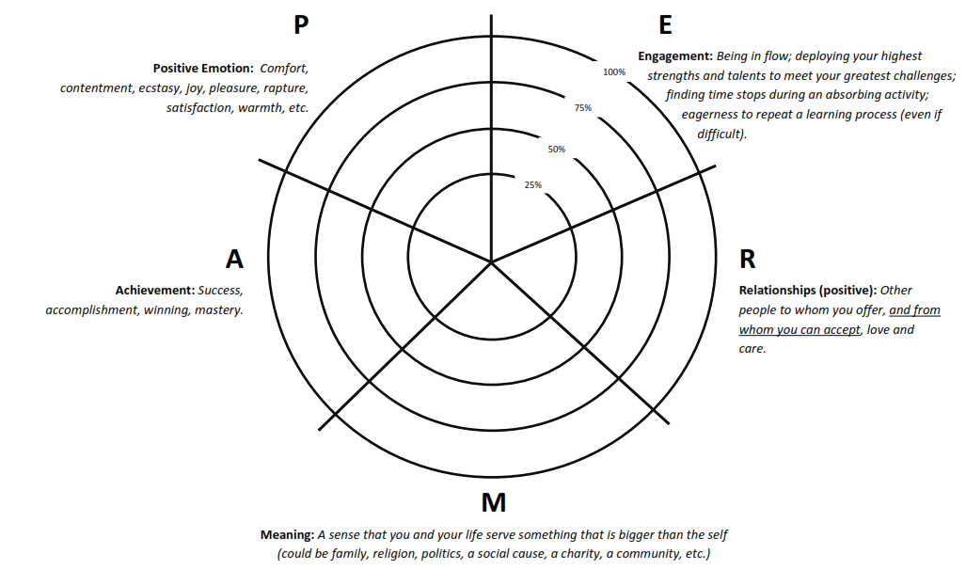
Notes:
Allied to CLANG. Martin Seligman.
Positve emotions (high and low energy) need 5:1 ratio of good to bad emotions to feel good at home, 3:1 at work
Enagement is being in flow
Meaning and purpose is here... Active is unique to CLANG
Connect
Learn
Active
Notice
Give
Not about work-life balance, but about LIFE.
Really good for working with patients too.

Slide 7
CLANG
Connect
Learn
Be Active
Notice
Give

Slide 8
next step?
Strengths [personal attributes which energise us, which feel like us and which enable optimal performance].
do the VIA [Values in Action]Survey of Character Strengths on the https://www.authentichappiness.sas.upenn.edu/ site. Need to register and then go to questionnaires - take note of your top 5

Slide 9
using your strengths
How could you use your strengths for new or different actions to help achieve those positive changes?
Notes:
Encourage to put strengths on e PO. How they cope with busy shift.

Slide 10
values
The moral principles that define you and your accepted standards
https://www.mindtools.com/pages/article/newTED_85.htm

Slide 11
further information
Martin Seligman you tube video
https://www.youtube.com/watch?v=e0LbwEVnfJA
Windmills skills analysis:
http://www.windmillsonline.co.uk/interactive/section_1/subsection_2/page1.html
Team role awareness [Belbin from yesterday]

Slide 12
The “C” word (!!)
Notes:
Control

Slide 13
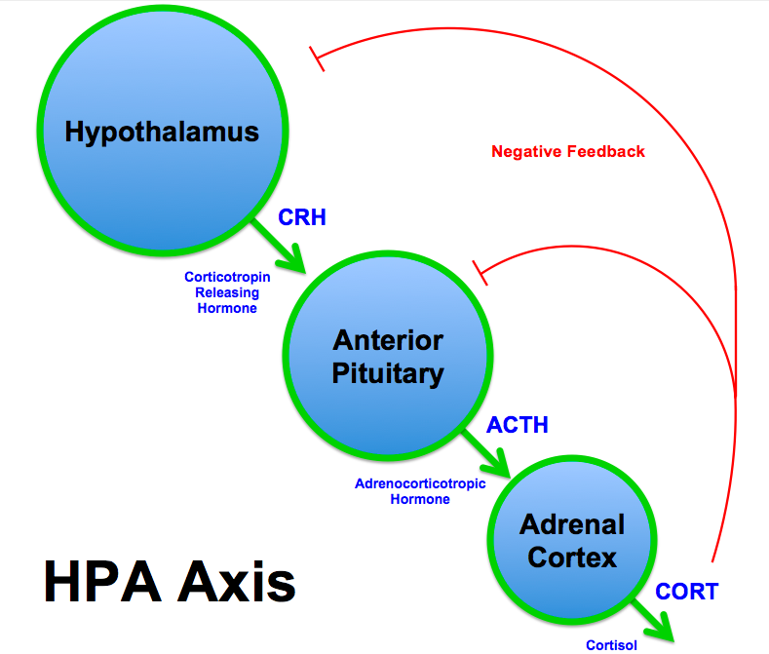

Slide 14
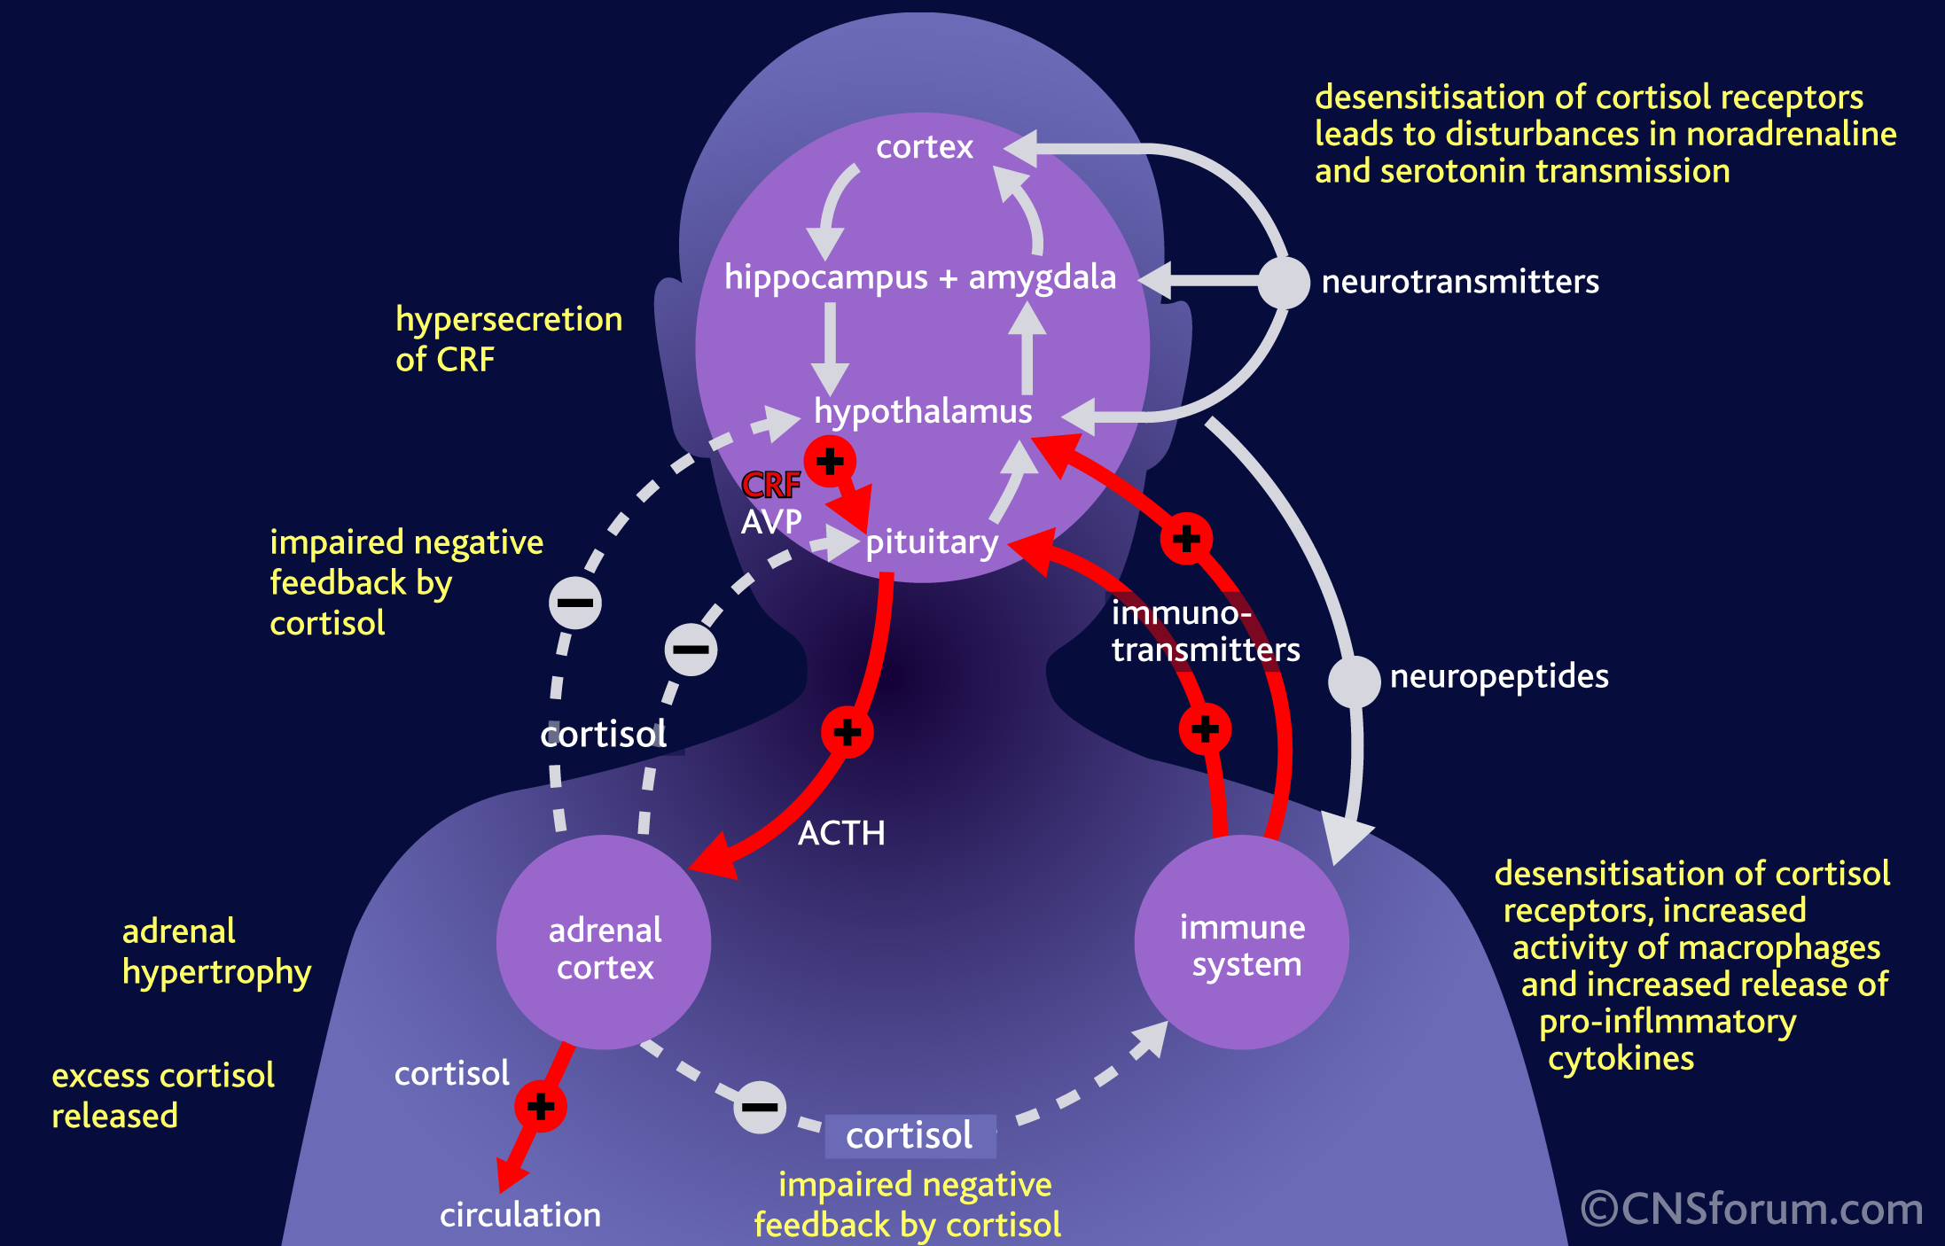

Slide 15
Emotions, Energy, Adrenals (exercise)

Slide 16
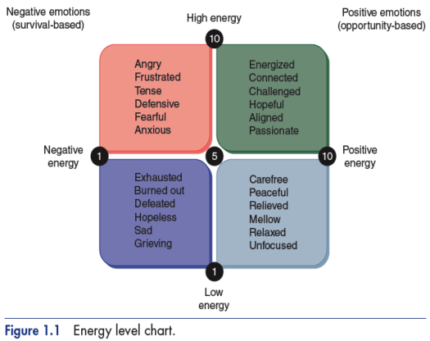
survival
performance
burnout
relaxed
Notes:
Trainees put the words into the quadrants.
Emotions are one worded feelings, not sentences.
Normal to spend time in different quadrants, but issues can arise if stay in one quadrant.
Challenge of unpredictable events, out of your control... Can leave you with elevated level of cortisol... Often in high energy negative- tense restless, can’t relax. And if not addressed, you end up in low energy negative.
How do you move your set point... Need DHEA production and activities which promote this. How do you move to here? Do things that generate low energy positive emotions. Para-sympathetic nervous system activity... “Rest and Digest”

Slide 17
