Slide 1
The role of the Physiotherapist in MSK
Jean Slavin MSc (Man Ther) MMACP MCSP
Lead ESP Physiotherapist, Outpatient Physiotherapy and Spinal Orthopaedic Clinic, Luton and Dunstable University NHS Trust
ESP and Triage Clinician for CIRCLE MSK services for Bedford and Rushcliffe
December 2018

Slide 2
Plan
What is the role of the physiotherapist and the ESP/advanced practitioner physiotherapist in MSK services
Limitations of Services
Common pathologies and how to manage them and when to refer to MSK services or orthopaedics

Slide 3
Role of the Physiotherapist in MSK Services
To assess patients for MSK conditions
To set a plan of action with the patient in conjunction with their realistic expectations and goals
To provide a rehabilitation programme for a specified, referred condition
To teach self management principles /processes to help reduce recurrence of symptoms
To escalate to MSK expert services for further management as required if patient not improving

Slide 4
Role of the GP in referring patients to MSK services
Make sure you are using agreed guidelines/pathways for referral as agreed by the GP fundholding services
Be aware of low priority referrals eg hallux valgus, ganglions, cysts
Screen for red flags especially cauda equina, inflammatory conditions, infections including TB, cancer as required. Potential fractures should not be sent to MSK.
Any patient with a recent change in their bladder/ bowel function/ perineal sensation will be rejected until a red flag pathway has been cleared.
Please do not refer for too many problems at one time – physiotherapists have limited appointment times too and funding often restricts the number of available follow–up sessions that can be offered

Slide 5
Role of the GP in referral
Send clear , concise information in your referral
If spinal pain with peripheralisation please include neurological findings you have found on examination
Indicate any history of injury; how long present and any previous treatment given to date including any investigations. If you suspect severe OA changes it would be helpful to streamline the patient pathway by organising appropriate x-rays/imaging prior to referral
Include any PMH but also systemic conditions that may affect treatment directly eg poorly controlled HTN , diabetes cardiac issues , osteoporosis
Include medication – patients never remember it !
Include things that prioritise urgent treatment eg unable to work, carer responsibilities–most MSK conditions should be managed in primary care for the first 4 weeks or so to allow for natural resolution of symptoms.

Slide 6
Role of the ESP/ advanced practitioner in MSK services
To assess patent and advised on management once initial conservative treatment has failed and to verify that the treatment given is an evidence based approach
To organise any relevant investigations to facilitate a change to the patients treatment pathway eg MRI, x-ray, bloods, USS
To administer injection therapy directly or via referral for USGI services
To advise on a further treatment pathway and facilitate this with direct referral within the MSK pathway or to pain management , rheumatology or orthopaedics once the appropriate investigations are completed
If the new treatment pathway is outside the MSK remit you may be asked to facilitate this eg neurology

Slide 7
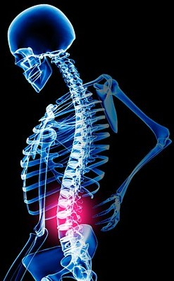
Back Pain
LBP – follow up to date NICE guidance – MRI is not advisable and lumbar x-rays should only be done if you suspect fracture or bony pathology
Manage with painkillers/ NSAIDs initially
Advise on self-management – keep active, gently exercise, use heat and avoid adopting poor postural habits while sore
Refer to physiotherapy after 4-6/52 when symptoms are not resolving with simple conservative measures

Slide 8
Role of the physio in Back pain
To get the patient moving as soon as possible
To facilitate early return to work if applicable
To teach self-management processes and advise on suitable exercises to achieve this
Manual therapy/hands-on treatment /acupuncture -can be used to help facilitate a more speedy return to exercise and movement but at 12/12 research shows patient who have received these treatments are no better than they would have been if they had just done exercises – the benefits are improvement in functional scores and pain levels at an earlier stage which can obviously enhance earlier return to work status
Chronic back pain without radiation that does not respond – pain management programmes such as iBEST, LEAP should be considered

Slide 9
Shoulder MSK Pathologies
4 basic possibilities:
OA/RA –restricted movements especially lateral rotation- gradual onset, probably no history of injury, problems dressing especially putting on coats/ jackets or doing up bra/tucking in shirt and reaching up and out, possible crepitus/graunching on movement,
rotator cuff pathology - often a history of injury but with degenerative tears they may have just had gradual or sudden onset catching pain +/- loss of strength- most over 50s will have rotator cuff pathology bilaterally although only one side may be symptomatic – they may have full lateral rotation and only get pain on specific movements where the muscle/tendon is either impinged or is symptomatic when it contracts
instability- usually after trauma eg dislocation or CVA/nerve damage - poor muscle control and strength
mixed picture – initially a probable rotator cuff pathology/impingement which then becomes stiff and a frozen shoulder/adhesive capsulitis develops

Slide 10
How to differentiate
Range of movement- capsular vs non capsular
Muscle weakness
Special Tests: Jobe’s (empty can), Hawkins Kennedy, belly press, sulcus sign, relocation test
Palpation
Simple advice to give prior to physio referral
Maintain good posture with shoulders back
Home heat/ ice advice
Painkillers/ NSAIDs as required
Maintain range of movement as much as possible, shoulder girdle and shoulder joint

Slide 11
Shoulder Pathology Management
Capsular vs non capsular
Capsular
Non Capsular
Weakness
Weakness
No weakness
No weakness
?OA/RA
?frozen shoulder
Recent onset/injury
Chronic
Possible significant rotator cuff tear + OA
Bloods if ?RA
Instability
X-ray to confirm if severe loss of range
Can be organised via MSK ESP service
Recent onset
Chronic
Injection
Injection
USS
MRI
USS
Physio/
rehab
Physio / rehab
?Surgery
? Surgery
REMEMBER patients who request surgery should understand that there is a very protracted recovery time involving a lot of rehabilitation exercising with which they are prepared to comply

Slide 12
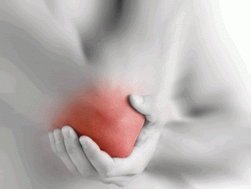
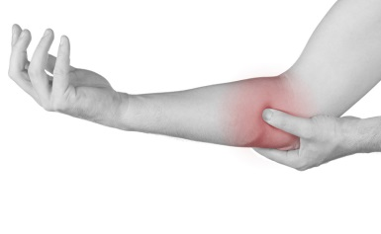
Tennis and Golfers Elbow
Tennis Elbow
lateral epicondyle
common extensor tendon
Pain on resisted index or middle finger extension with elbow and wrist extended
Treatment:
Ice/heat, self massage/epiclasp/tape
Stretches into flexion/ulnar deviation
Eccentric/ concentric loading exercises for finger/wrist extensors
INJECTION NO LONGER RECOMMENDED – non inflammatory condition
Shockwave Therapy – no evidence to support use
Golfers Elbow
medial epicondyle
common flexor tendon
Pain on resisted finger and wrist flexion with elbow extended
Treatment:
Ice/heat, self massage/epiclasp/tape
Stretches into extension/radial deviation
Eccentric/ concentric loading exercises for finger/wrist flexors
INJECTION NO LONGER RECOMMENDED – non inflammatory condition
Shockwave Therapy – no evidence to support use

Slide 13
Moderate/ Mild OA and PF joint OA
Strengthening exercises – quads, balancing, functional exercises
Home heat
Flexibility Exercises
Use of walking aids if required
NWB exercising eg swimming , aquerobics, cycling
Targeted physiotherapy
MRI not recommended for over 50s unless they have true locking or giving way
Arthroscopies limited in over 50s unless locking or giving way with confirmed pathology on imaging other than degenerative posterior horn tears – increased likelihood of accelerating degenerative changes

Slide 14
Trochanteric Bursitis or Gluteal Tendinopathy?
Pain lateral thigh/hip/ buttock
Locally tender to the postero lateral aspect of the greater trochanter
Can be associated with a Trendelenberg gait
Weakness of hip abductors and gluteal muscles
Current evidence supports gluteal tendinopathy as diagnosis
Only consider injection once conservative measures fail or if unable to do exercising due to severe pain specifically over the bursa

Slide 15
When to refer for surgery
Hip OA
Oxford Hip Score below 19
ie significant loss of function
Severe degenerative changes on a weightbearing x-ray
High Visual Analague Score
BMI within accepted limits
Patient wishes to have surgery and is systemically fit enough
Knee OA
Oxford Knee Score below 19
ie significant loss of function
Severe degenerative changes on a weightbearing x-ray
High Visual Analague Score
BMI within accepted limits
Patient wishes to have surgery and is systemically fit enough

Slide 16
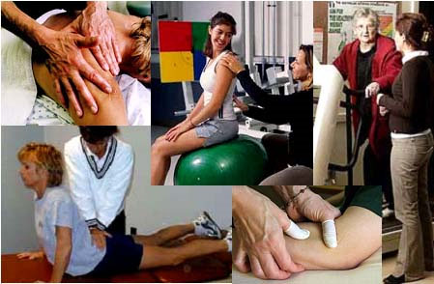
Thank you
Any Questions?

