Slide 1
Recognising stress and building resilience

Slide 2
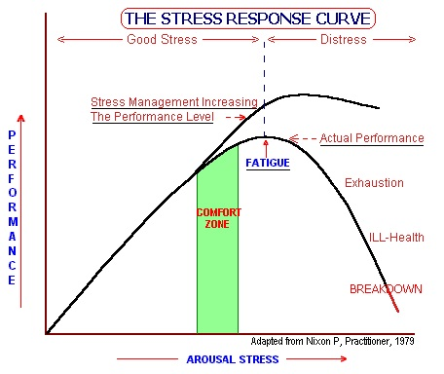
Notes:
We are trying to increase your comfort zone and give you tools to move between the lines so that you are resilient and robust and when things go wrong, you have the reserve to cope. Developing resilience can shift you to the top line, where performance continues to increase as stress increases, and when performance reduces, it is not to such a degree as if you are less resilient

Slide 3
Where are you on the stress curve?
Recognise when:
You are lacking “arousal” – are you underperforming, or learning too slowly
You are working at your peak – how long can you sustain it in the short term and the long term?
You are “over the top”
You are at the “point before point of no return”:
At the point of exhaustion and ill health you have gone too far for too long

Slide 4
Building your Resilience
What strengths do you think you have which help you to be more resilient?

Slide 5
Resilience
Attitude and perspectives
valuing what you do as a doctor, maintaining interest in the job, developing self-awareness and accepting your own limitations
Balance and prioritisation
setting limits, work life balance and looking after and valuing yourself, taking effective approaches to CPD
Organisation of your work environment
good management, having good staff, effective systems at work
Supportive relationships
positive personal relations, effective professional relationships and good communication

Slide 6
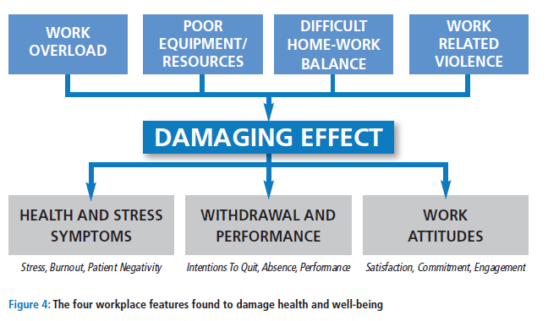

Slide 7
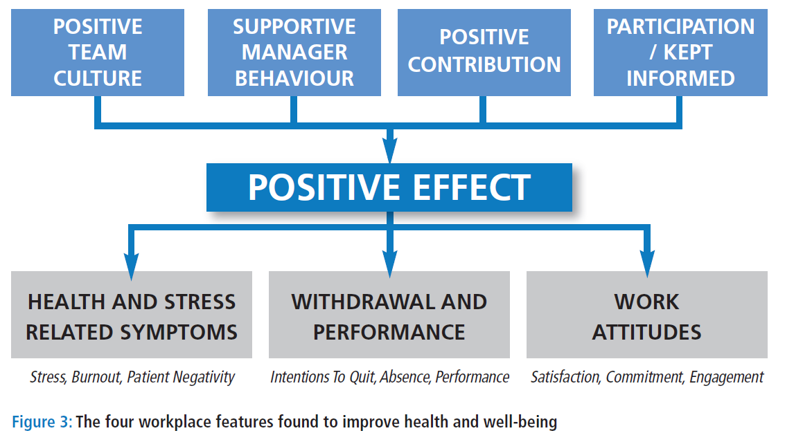
Partnership for Occupational Safety and Health in Healthcare, 2012

